Slide 1
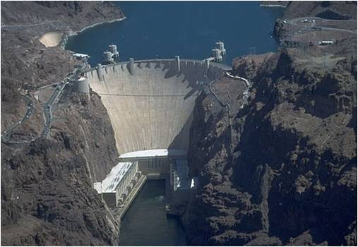
Hoover Dam

Slide 2
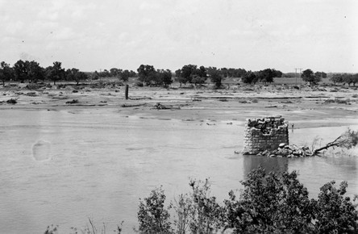
Purpose
Flood control
Improvement of navigation
Regulation of Colorado river
Hydroelectric power production
Generates 4 billion kilowatt-hours a year

Slide 3
Timeline
1929-June: Herbert Hoover takes charge of negotiations as six of seven basin states approve the Colorado River Compact.
1931-March: The contract is awarded to Six Companies, a construction and engineering firm made up of some of the West's most successful builders and designers of dams, bridges, roads, and tunnels, on March 11. The winning bid was $48,890,995.
1932-November: The Colorado River is diverted around the dam site.
1933-June: First concrete is poured at Hoover Dam site.
1935-February: The Hoover Dam starts impounding water in Lake Mead.
1935-May: The last concrete is poured at the dam site.
1935-September: President Franklin D. Roosevelt attends and speaks at the dedication of Boulder (Hoover) Dam.

Slide 4
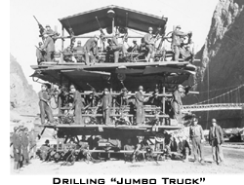
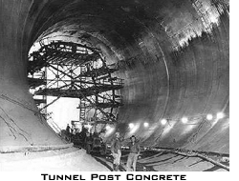
4 Diversion Tunnels
Purpose: To divert the Colorado River for Construction
Drilling Jumbo Trucks
20 to 30 men to simultaneously drill holes for blasting powder
56 ft diameter
3ft concrete lined walls
Almost 4,000 cubic yards of concrete went into tunnels
River flowed through tunnels for two years
405 ft thick plugs were placed on two tunnels and later the remaining two were plugged

Slide 5
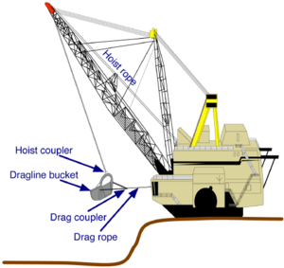
Concrete Facts
Alluvial lens just over six miles upstream on the Arizona side of the river was chosen as the source for aggregates.
The deposit covered more than 100 acres thirty to thirty-five feet deep
A dragline was used to excavate the aggregate and load it into rail cars.
The cars hauled the aggregate to a screening and washing plant on the Nevada side of the river at Hemenway Wash
Dragline

Slide 6
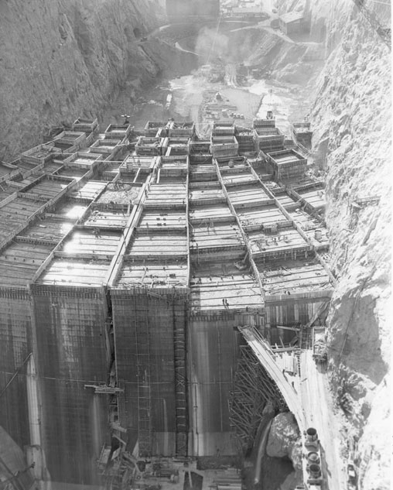
Continue…
Base required 230 individual gigantic blocks of concrete from 25 to 60 square feet
Dam itself used 3,250,000 cubic yards of concrete
concrete was placed in the dam using 4 and 8 cu .yd. bottom dump buckets
Would of taken 100 years for concrete to properly cure without engineering intervention.
Imbedded with over 582 miles of one inch steel pipe through the interconnecting concrete blocks that circulated ice water and later backfilled with concrete

Slide 7
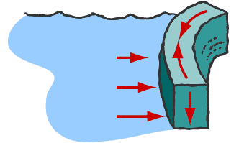
How can Hoover Dam withstand the massive pressure and weight of Lake Mead?
Dam curves against lake mead and is fortified against the massive rock walls of black canyon.
45,000 pounds per square foot water pressure held back by gravity
Water compresses against the curved walls and the canyon walls push back counteracting

Slide 8
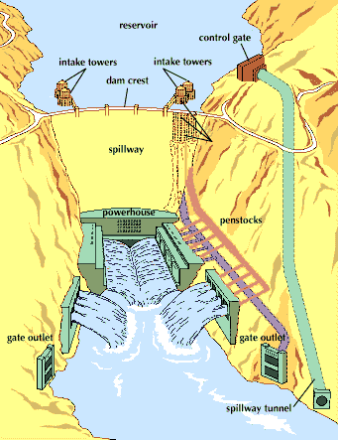

Slide 9
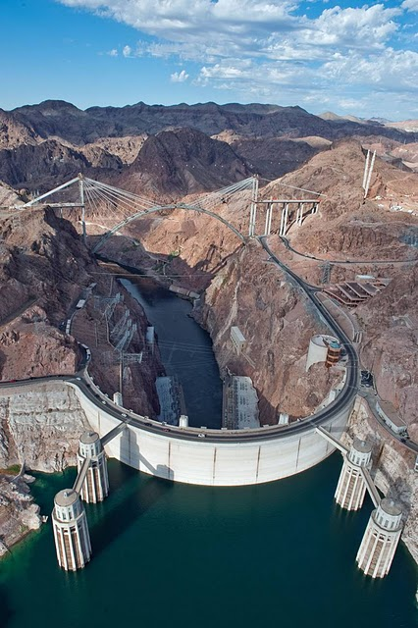
Final Product
Type: Arch gravity
Height: 726.4 feet
Crest length: 1244 feet
Crest Width: 45 feet
Base width: 1660 feet
Volume of concrete: 4.25 million cubic yards

Slide 10
Fun Facts
Construction workers’ hard hats were invented and first used in Hoover Dam.
Reservoir can store enough water to cover the state of Pennsylvania to a depth of one foot.
Enough concrete in Hoover Dam to build two lane highway from Seattle Washington to Miami Florida or a four foot wide sideway around earth at its equator

Slide 11
Sources
http://www.arizona-leisure.com/hoover-dam-building.html
http://www.aboutcivil.com/the-hoover-dam-details.html#
Hoover Online. Herbert Hoover Presidential Library and Museum http://www.ecommcode.com/hoover/hooveronline/hoover_dam/const/toc.html
http://lifelong.engr.utexas.edu/about/hoover.cfm
http://www.google.com/imgres?imgurl=http://media.web.britannica.com/eb-media/55/
http://www.engineering.com/Library/ArticlesPage/tabid/85/articleType/ArticleView/articleId/64/Hoover-Dam.aspx
http://www.footnote.com/page/83001611_hoover_dam/
http://www.usbr.gov/lc/hooverdam/History/essays/tunnels.html

